Slide 1
How to Incorporate the Side Information: Decomposed Gaussian Process Regression Algorithm

Slide 2

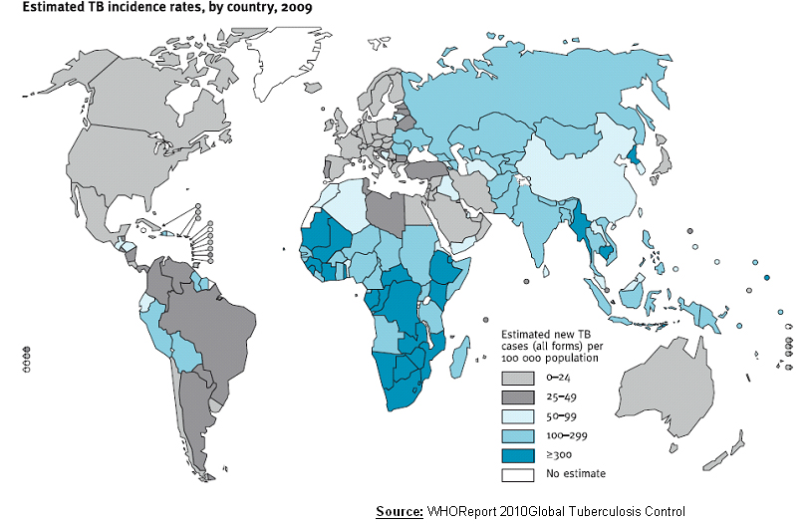
Tuberculosis Prevention
Tuberculosis affects One thrid of the global population and kills 1.5 million people every year, more than malaria and HIV.
Notes:
Tuberculosis is a major worldwide challenge.
People have tried to prevent Tuberculosis with various methods, e.g. different kinds of vaccine.
These vaccines have successfully reduced the infected population in many countries.

Slide 3

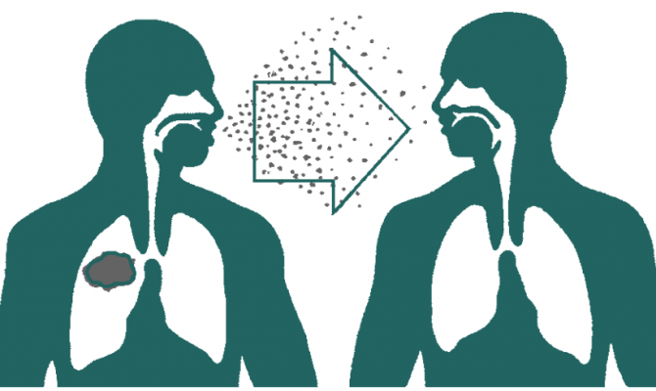
Tuberculosis Prevention
Limited budget
Uncertainty to the real world disease
Notes:
However, vaccines are very expensive and the treatment also takes time and requires extremely large amount of people working on it.
Most of the poor countries do not have enough budget and human resource.
What they can do is to use the limited budget and try to minimize the spread of the disease.
Most of the time, they only have limited number of vaccines, which can only be applied to a portion of patients.
How to intervene the disease and how to stop the spreading of the disease by limited budget becomes a crucial problem.
Moreover, we know only little about the disease.
Even though there are plenty of studies and models about Tuberculosis, the disease is also country-specified.
It shares some common features but not all.
We have to learn the disease from sampling.
And the samples are also noisy.
Patients do not always tell doctors the truth.
The model must include uncertainty to adjust these problems.

Slide 4
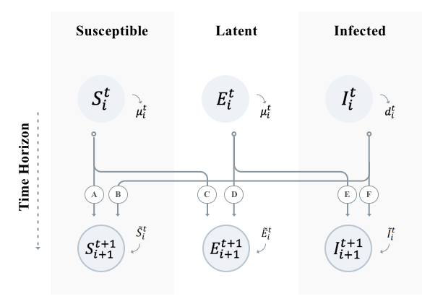
SEIS Model
Analytical model. Commonly used as a disease model.
Pros: easy to compute and reach an approximated optimal solution (Bryan et. al. AAAI 2018)
Cons: not flexible, it is domain specified and unable to capture randomness.
Notes:
The traditional analytical model with three states at each age groups.
It captures the transition between different states.
It also considers the death rate and incoming population.
There are plenty of previous works studying the SEIS model.
For example, Bryan et. al. indicates that we can find an approximated optimal solution on this analytical model.
However, the model is deterministic with no uncertainty.
It cannot deal with any randomness and it is also not flexible.

Slide 5
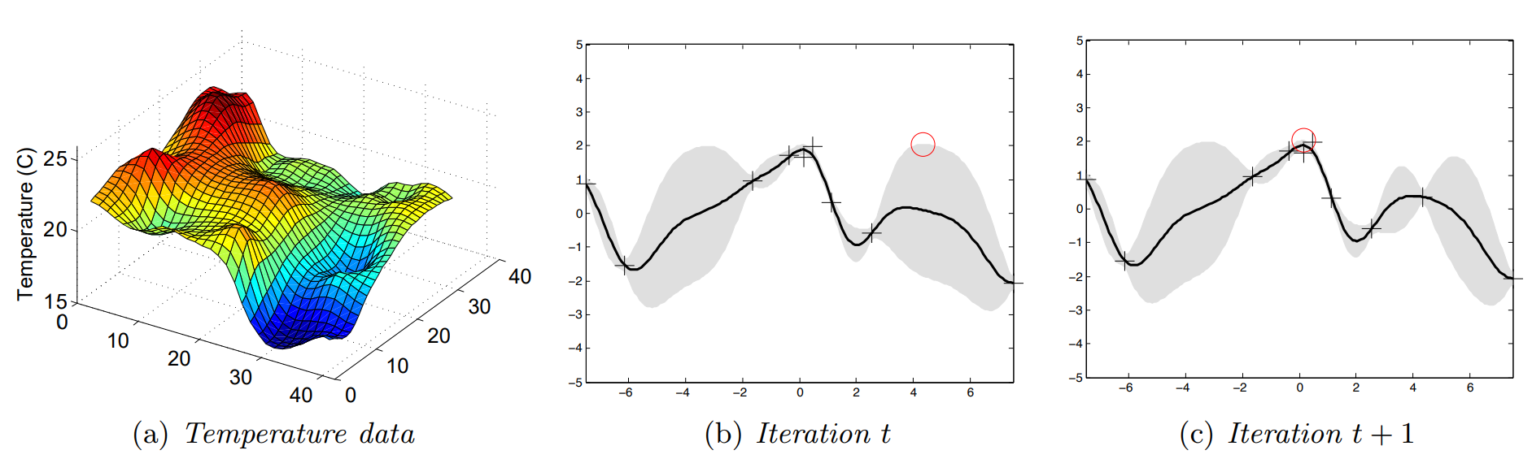
Gaussian Process Regression
One of the most popular non-parametric models. Only require assumption on the smoothness (GP kernel).
Pros: very generalized.
Cons: sample complexity is extremely large. Require much more data to learn the target function.
Srinivas et. al. ICML 2010
Notes:
Gaussian process has become a popular non-parametric method.
It only requires the assumption on the smoothness of the target function.
It is very flexible and it can approximate any function as long as it is smooth enough.
However, it requires huge amount of samples to learn even just a simple function.
It is impractical in real-world since we usually don’t have that much data or previous samples.

Slide 6

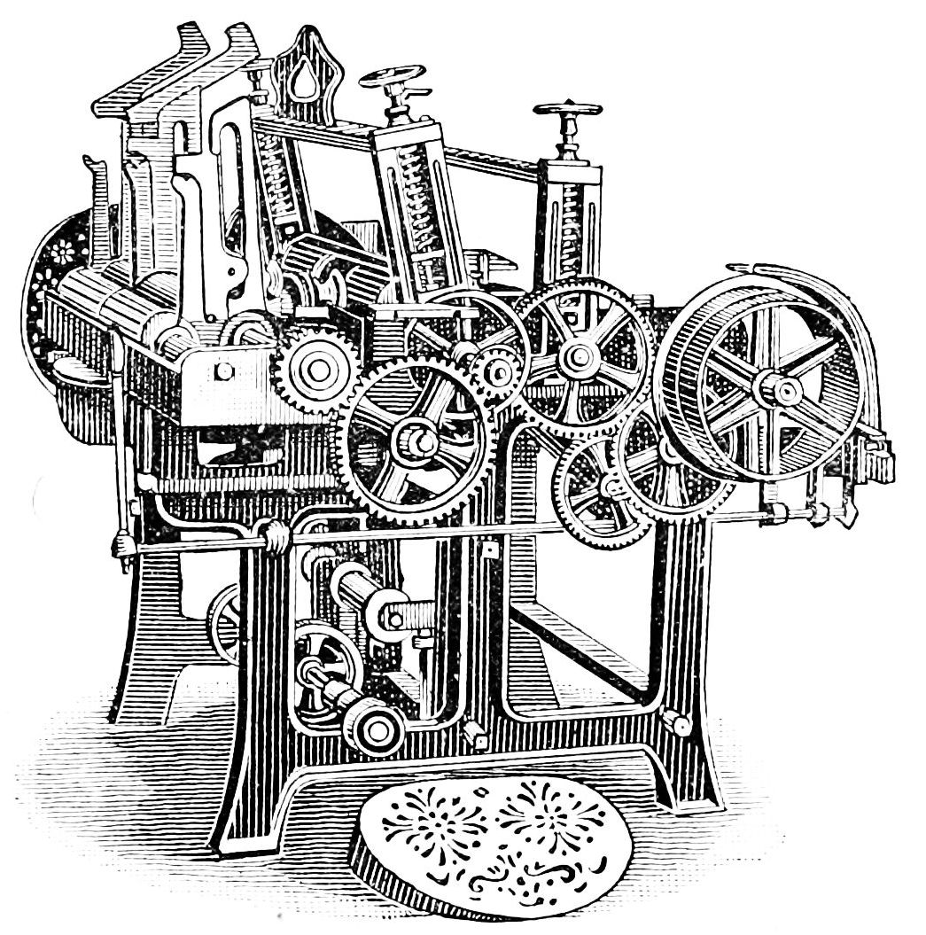

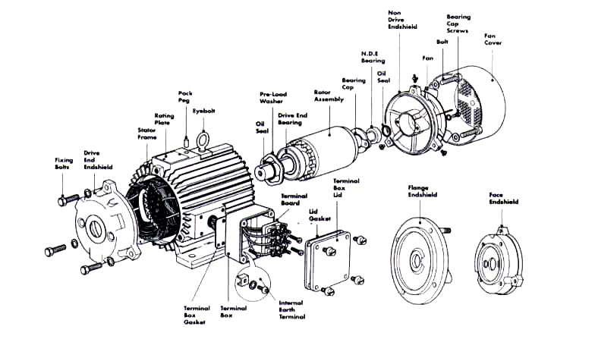
Our method
We assume there are errors in each part of the analytical model.
Run samples and observe the errors on top of model.
Apply Gaussian process regression to each part and learn the error function.
Reconstruct the model with learned error functions, which provides a more accurate approximation.
Notes:
Therefore, we come up with a hybrid model.
We base on the analytical model to predict the target function.
While sampling, we observe the error in each part of the model and revise the error by learning the error function.
After learning, we can reconstruct the model and provide a better prediction.

Slide 7
Concrete Example: Tuberculosis
Side Information!!
Our objective value is the total infected population.
Within every sample, we know the infected (susceptible, latent) population at each age (side information).
Based on an age-wise model (SEIS model), learn the error of the SEIS model at each age by GP-regression
Reconstruct the SEIS model with learned errors, which provides a more accurate model.
Notes:
In the tuberculosis example, the target function is the total infected population.
And our side information is the infected population at each age.
We can apply the SEIS model, a age-wise model, to predict the disease.
While sampling, we can observe the infected population at each age and use these side information to make the SEIS model better.
After learning the error functions, reconstruct the SEIS model and make a better prediction.

Slide 8
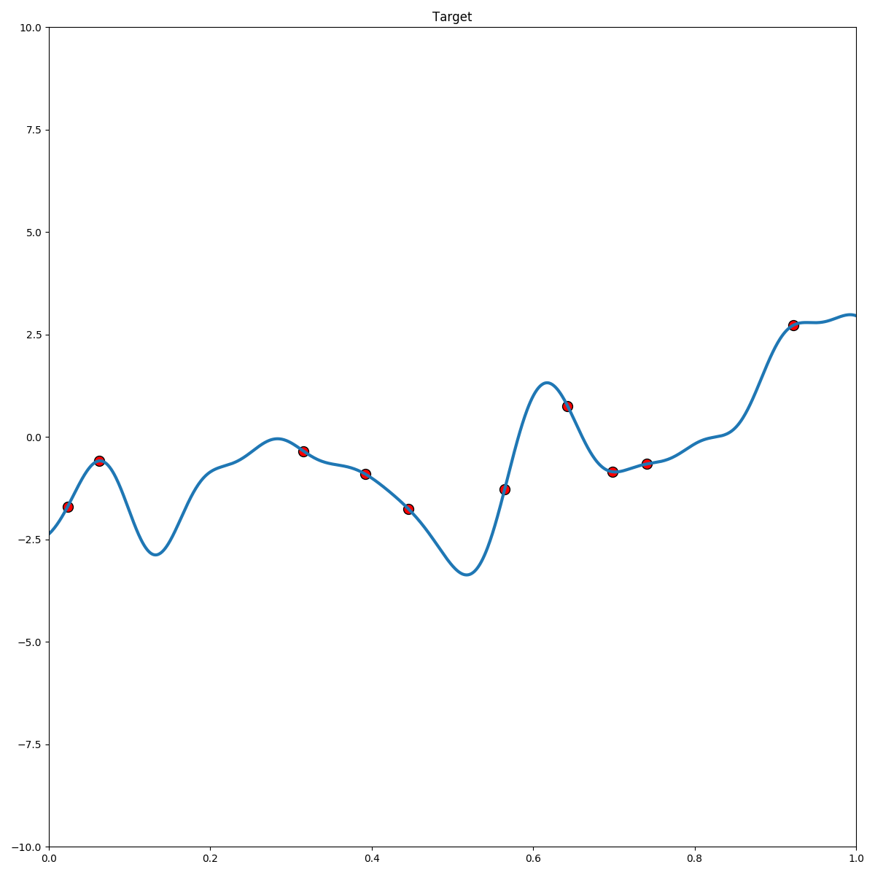
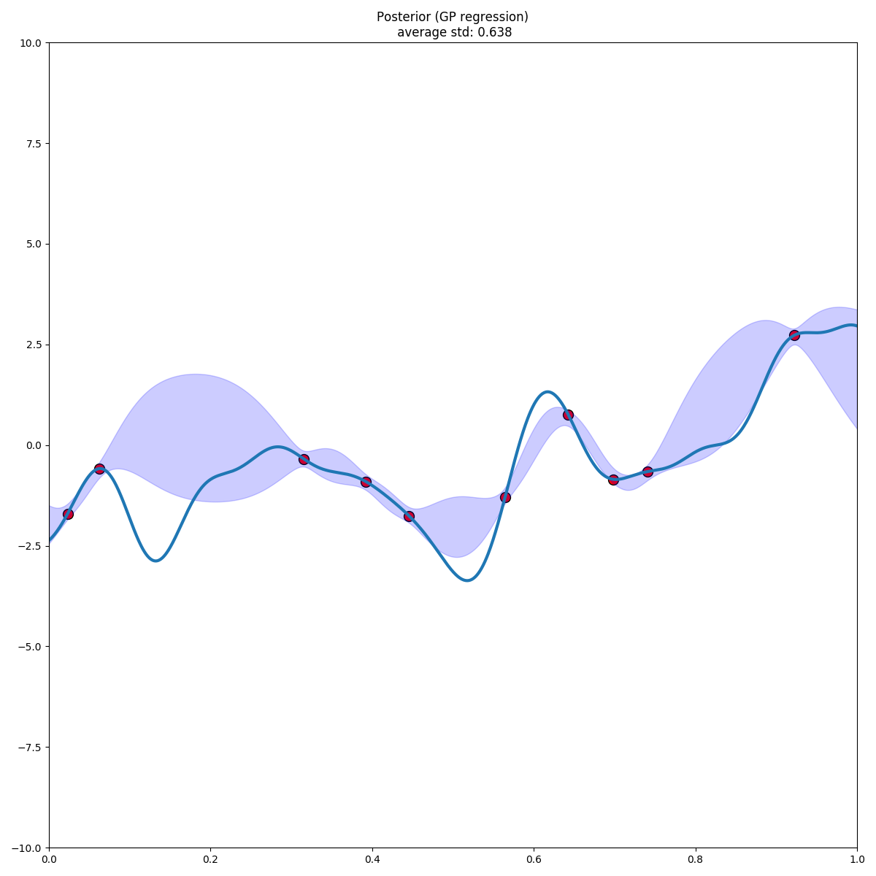
Gaussian Process Regression
Unknown function
Observed samples
Posterior belief
Notes:
Here is an illustrative example.
If we have an unknown function.
We can access to it by sampling at some points.
According to the smoothness condition, we can learn the posterior belief of the function at those places we haven’t explored.

Slide 9
Decomposition
Unknown function
Observed samples
Posterior belief
Notes:
But suppose we have some knowledge of the unknown function.
We know the unknown function can be decomposed into 4 subfunctions.
And while sampling, we can also observe the outcome of each subfunction.

Slide 10
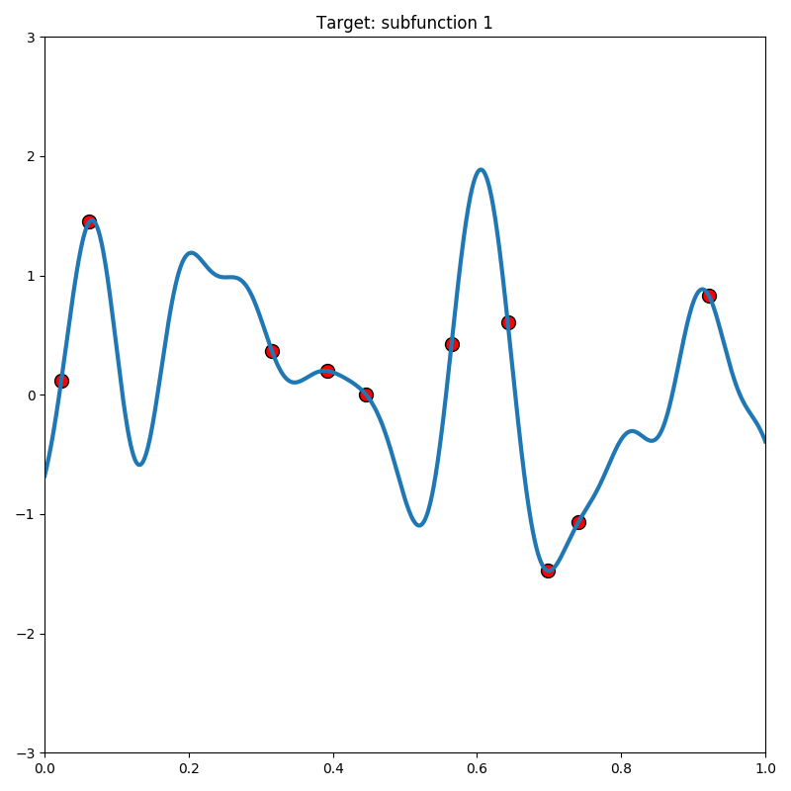
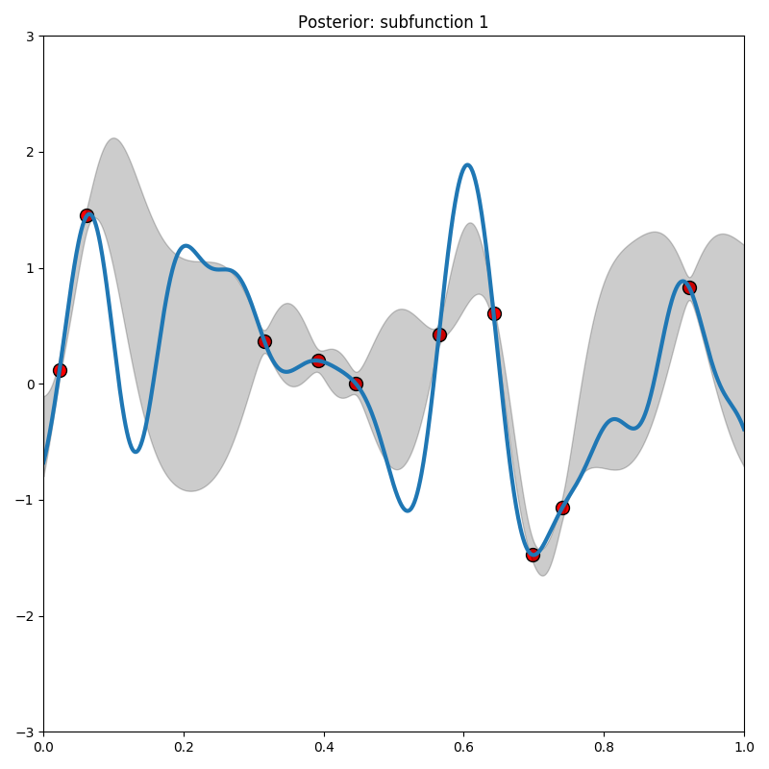
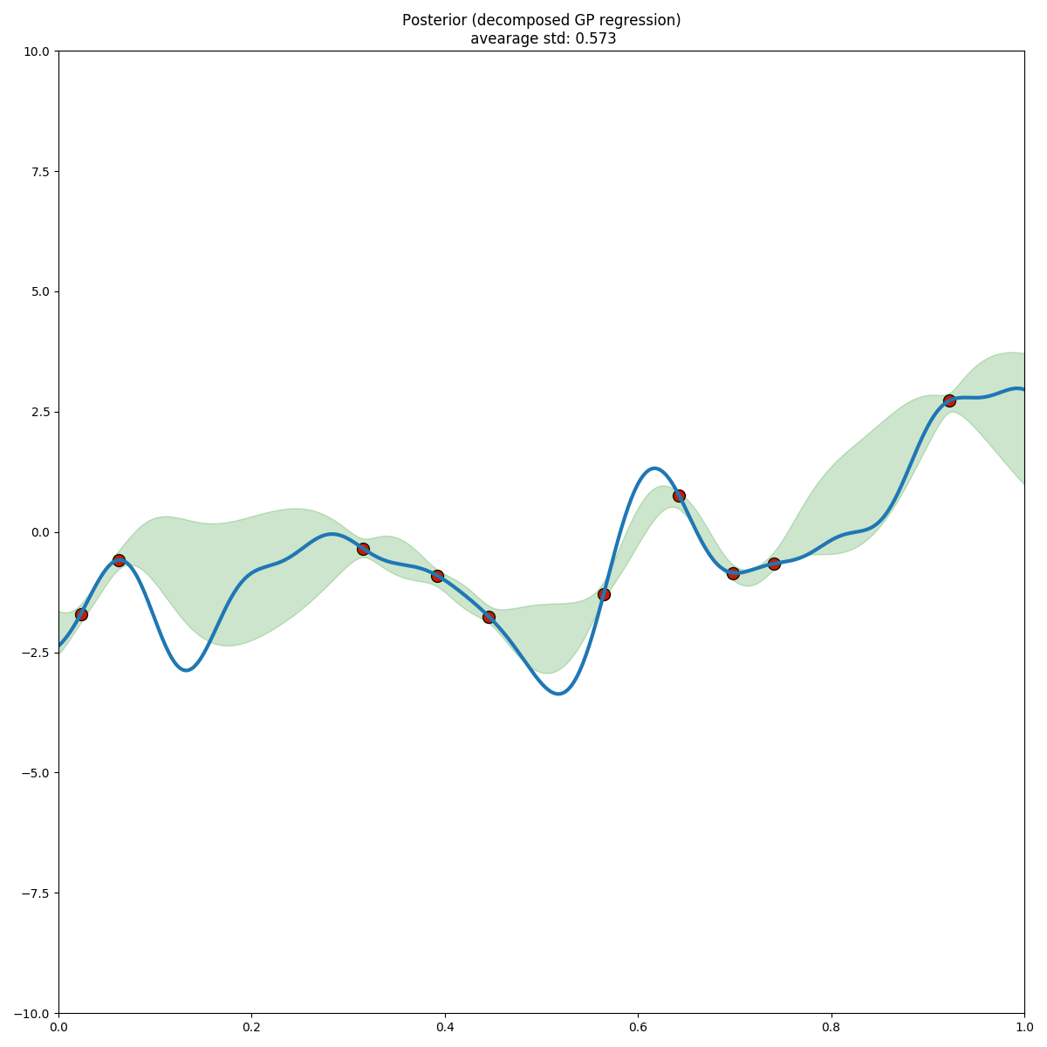
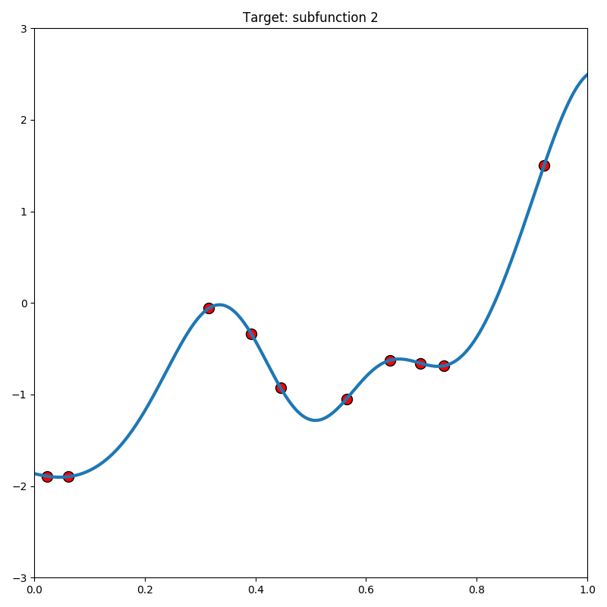
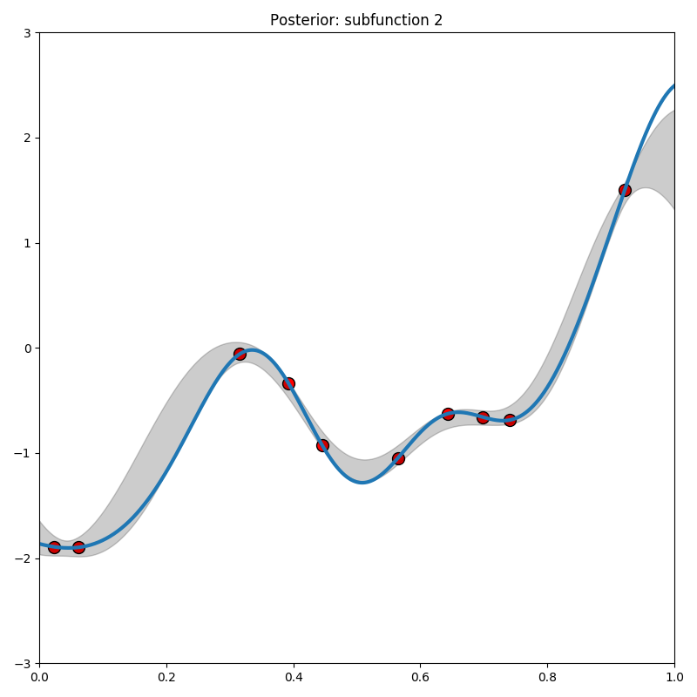
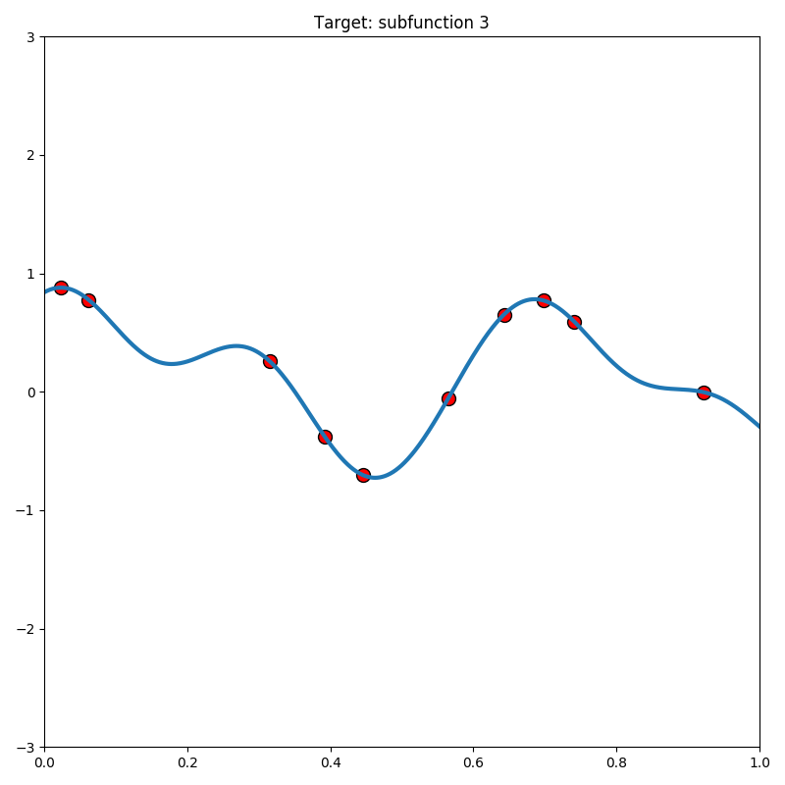
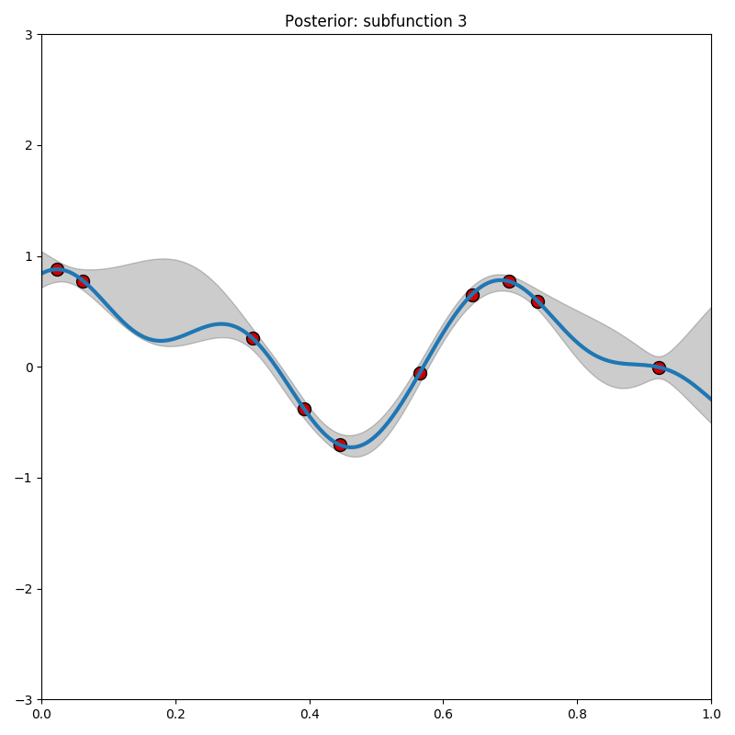
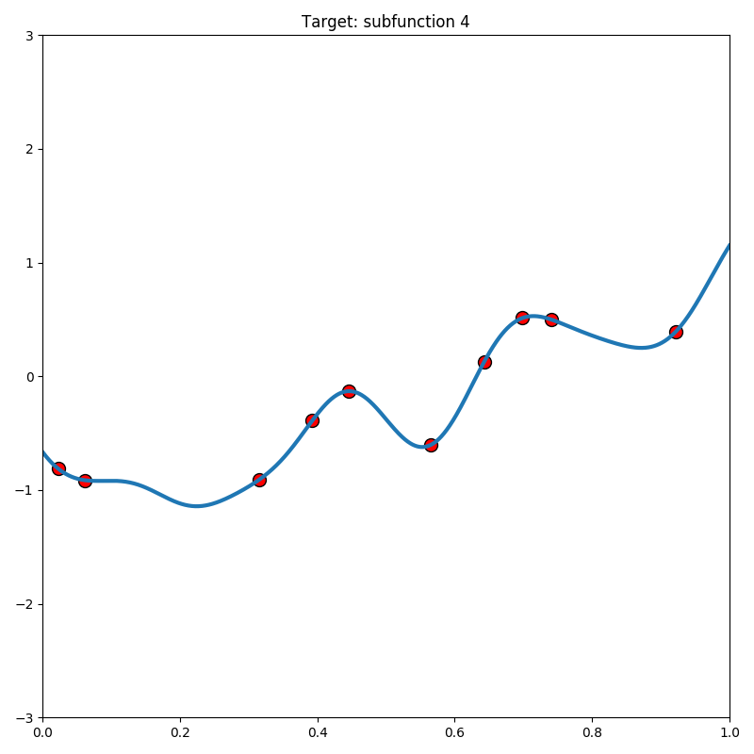
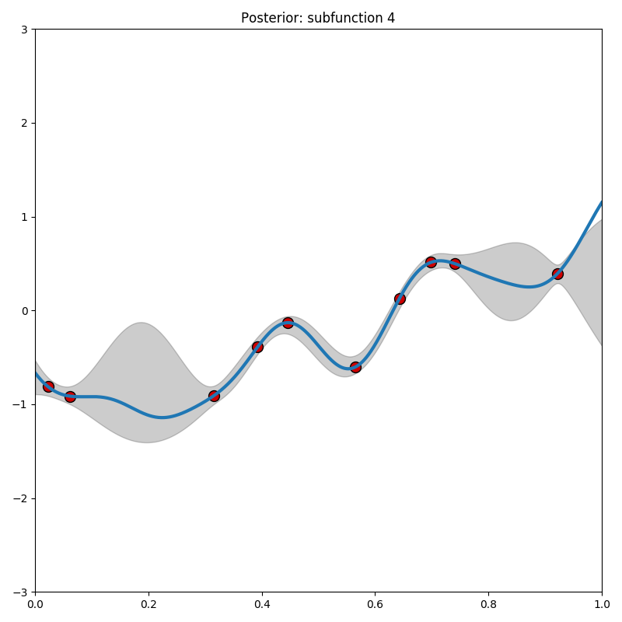
Decomposition
Unknown function
Observed samples
Posterior belief
Notes:
We can decompose the unknown function.
Then we access the function to get some samples.
But now we can observe the outcomes of each subfunctions.
So we can learn each subfunction individually.
After learning them, we reconstruct the original function.

Slide 11
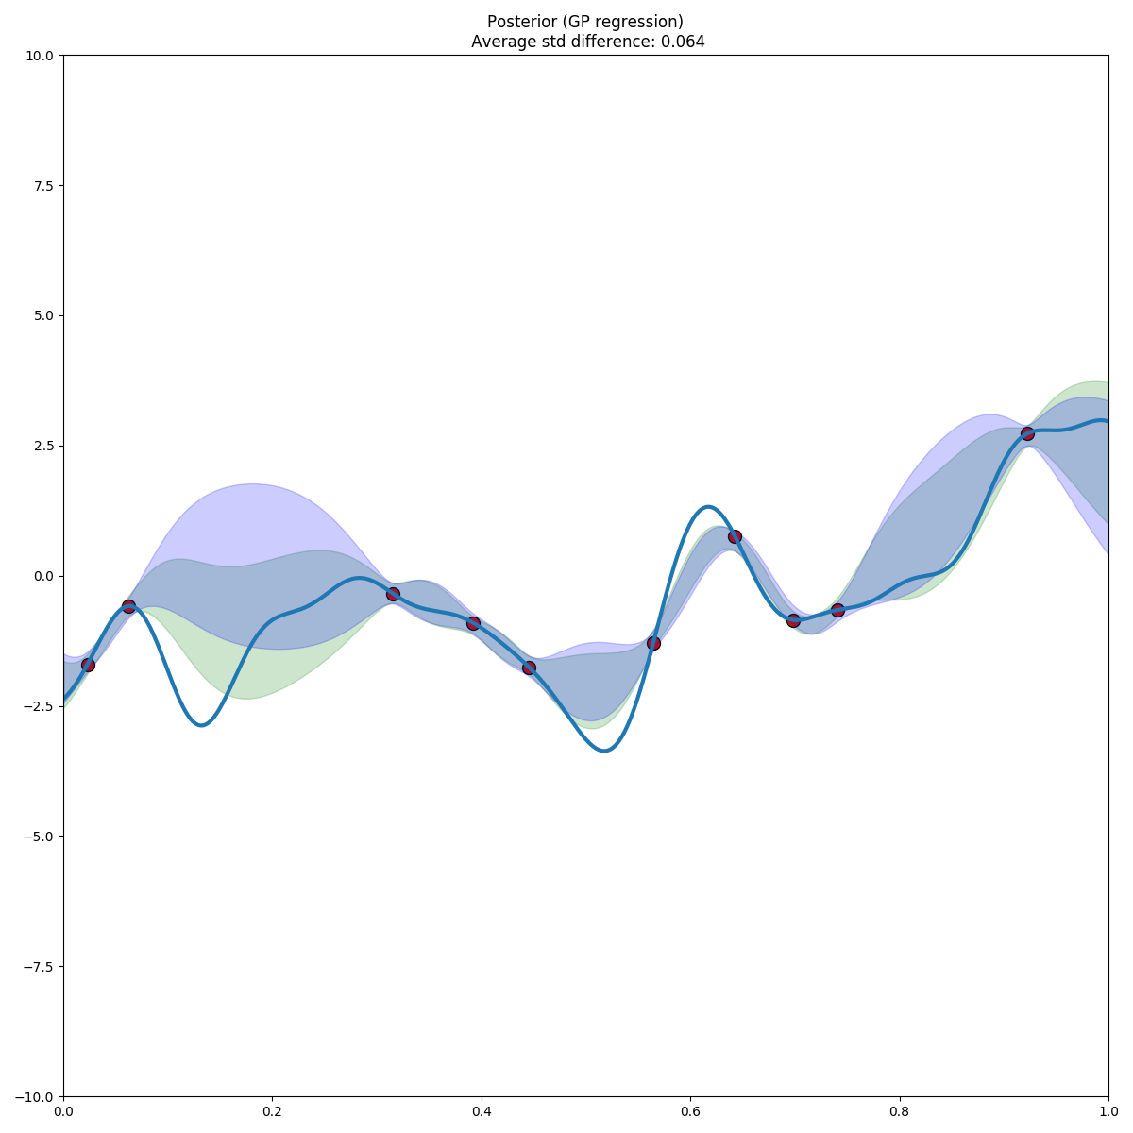
Decomposed Gaussian Process Regression
Posterior belief
Notes:
If we compare the result of these two methods, you can see the green one (our method) provides a more accurate prediction by using these side information.
We have proved that using our method can always improve the quality of the approximation.

Slide 12
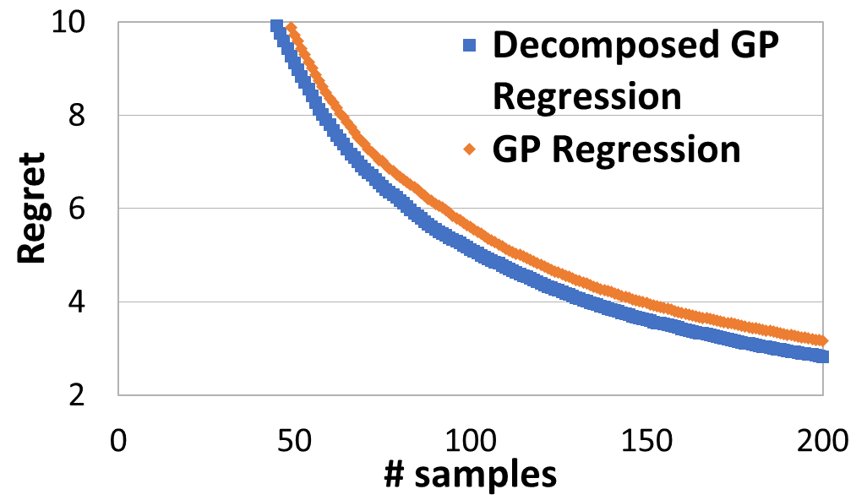
Application to online learning
Notes:
(This page is selective, we didn’t mention too much about the bandit setting. So it might be misleading here.)
Furthermore, if we apply our method to the bandit setting.
In order to balance exploration and exploitation, we need a good approximation on the target function.
It is easy to imagine our method with a better approximation can improve the exploration and exploitation as well.
This is an one-dimension example showing our cumulative regret (the loss of not using the optimal solution or the loss of exploration) is less than using just GP regression.
This directly reflects the quality of exploration v.s. exploitation.
Our method can achieve more reward (less regret) while doing exploration and exploitation compared to the previous method.
In Tuberculosis case, we can save more people by using side information, which was ignored before.
This side information is very helpful. It helps us to understand the disease more quickly and save more people in time.

Slide 13
Summary
Fully utilize the side information
Better approximation
Less sample complexity and less regret
Hybrid model of analytical model and non-parametric model
Notes:
We can fully utilize the side information provided by samples.
By doing so, we can derive a better approximation.
Therefore we need less samples and also incur less regret while sampling.
This method is also a very generalize method, which only requires an analytical model and useful side information.
In the real world, side information is everywhere.
E.g. if we want to maximize the advertise revenue by delivering ads to people, we can either learn the response of people with respect to certain types of ads.
Or we can learn the response of people from different age groups, where the total revenue is just the summation of the revenue from all the age groups.
This also accounts for one kind of side information.
Our hybrid model can learn more quickly and predict better.

Slide 14
Reference
Bryan Wilder, Sze-Chuan Suen, Milind Tambe, 2018. Preventing Infectious Disease in Dynamic Populations Under Uncertainty
Niranjan Srinivas, Andreas Krause, Sham M. Kakade, Matthias Seeger, 2010. Gaussian Process Optimization in the Bandit Setting: No Regret and Experimental Design
Suen, S.; Bendavid, E.; and Goldhaber-Fiebert, J. 2015. Cost-effectiveness of improvements in diagnosis and treatment accessibility for tuberculosis control in india
Rasmussen, C. E. 2004. Gaussian processes in machine learning

Slide 15
Photo Reference
Photo by Michael Longmire on Unsplash
This Photo by Unknown Author is licensed under CC BY-SA
This Photo by Unknown Author is licensed under CC BY-NC-SA
This Photo by Unknown Author is licensed under CC BY-NC-ND
Photo by Yi Lee
Photos from http://trinitynews.ie/trinity-academic-warns-against-complacency-as-cases-of-tuberculosis-rise/, https://www.diagnostics.eu.tosohbioscience.com/solutions/pathologies/tuberculosis-pathology-and-diagnosis, and http://www.gbcghana.com/1.11921047

